Slide 1
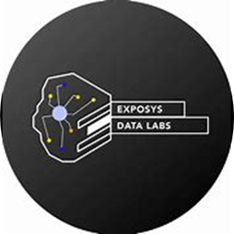
Exposys Data Labs
Data science Internship
Name: Deep Uthale

Slide 2
Contents:
Introduction
Proposed Methodology
Model Building
Experimental results
Conclusion

Slide 3
Introduction:
Based on the R&D Spend, Administration costs and Marketing Spend of 50 companies along with profit, We have to prepare an ML model which can predict the profit value of a company if the R&D Spend, Administration costs and Marketing Spend are given.
And to build such a kind of model we are going to use linear regression from regression models. Linear Regression models are used when the relationship between the predictor variable(s) and the response variable is reasonably linear and The response variable is a continuous numeric variable.

Slide 4
Proposed Methodology:
We need a way by which we can analyze our expenditure on the start-ups and then know a profit from them. The Python programming language will be quite helpful in such a situation where we need to find a profit based on how much we are spending in the market and for the market. In a nutshell, will help to find out the profit based on the amount we spend from the 50_ Start-up dataset.
Data Scientists need to prepare the dataset and need to perform the Data pre-processing and Data cleaning. Data analysts need to analyze the data set and predict the solution.

Slide 5
Model Building:
Step 1: Import Libraries (Numpy, Pandas, Matplotlib and seaborn)
Step 2: Load the Dataset and Create the Data frame
Step 3: Basic Information of Data frame (Understanding of data)
Step 4: Visualization (Understanding the data with visualization)
Step 5: Data Cleaning
Step 6: Creation of Dependent(y) and Independent(x) variables
Step 7: Split the dataset into Train and Test
Step 8: Build the model
Apply Linear Regression on Train Dataset
Step 9: Apply the Model on the Test dataset to get the predicted values
Step 10: Compare the Actual output(y_test) values with the predicted(y_pred) values
Step 11: Evaluation Metrics of the Regression Model

Slide 6
Experimental Results:
By building our model and training it on the training dataset and testing it on the test dataset we got the results:
Predicted values
Working Linear Regression Model
Accuracy of Model
R2 Score of Model
So we got 94% predictive power from our predictive model.

Slide 7
Conclusion:
Based on the findings, we conclude that our dataset does not require any cleaning and profit is the most important feature of our dataset. In general, our predictive algorithm has a 94% predictive power to predict the profit value of the company based on R&D Spend, Administration cost and Marketing Spend.

Slide 8
Thank You

